Slide 1

Moderni eksperimenti
Prikazivanje podataka u realnom vremenu koristeći Arduino i Python

Slide 2
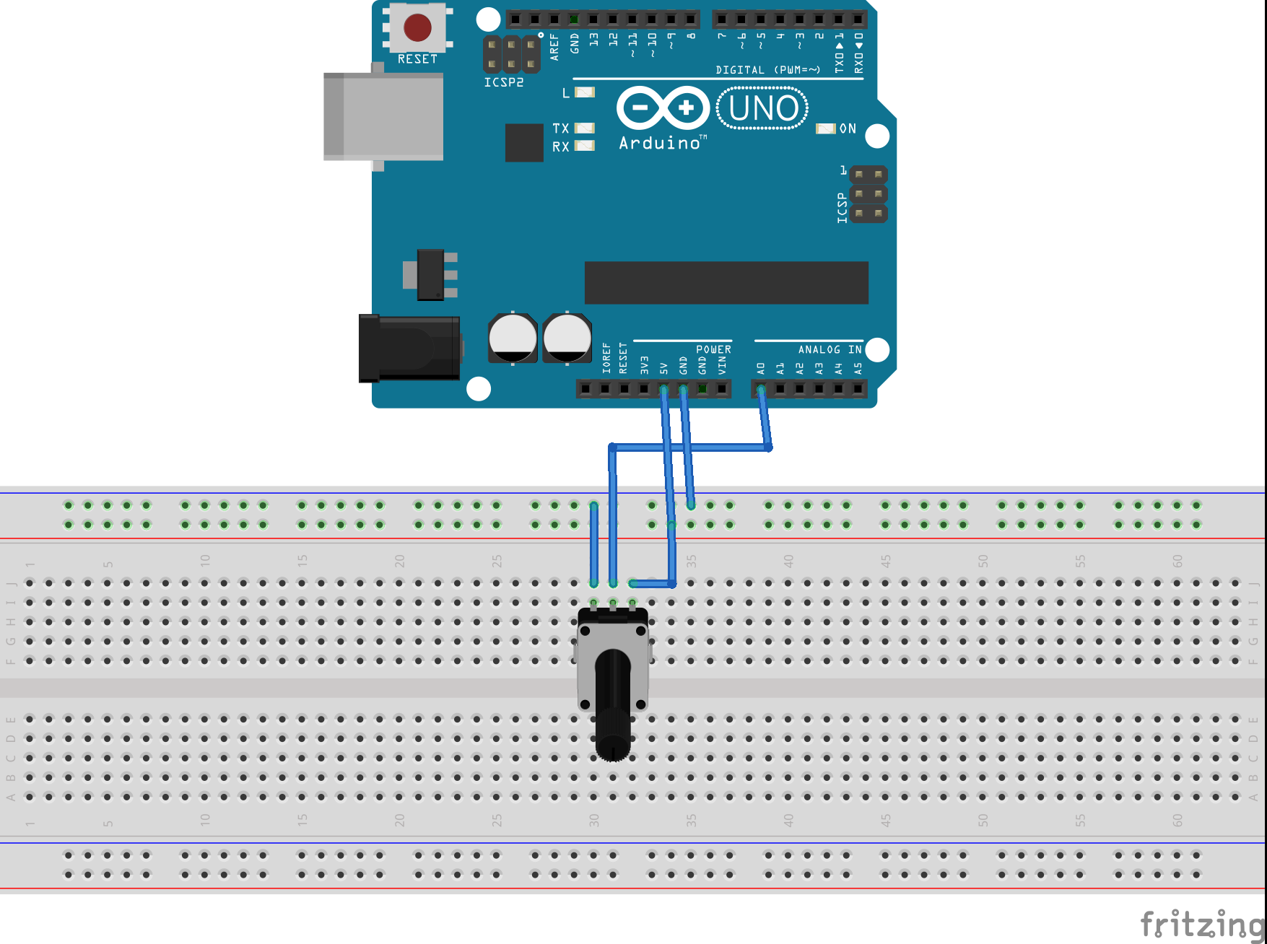
Arduino
example Basic\Blink.ino
potenciometar
Serial.begin(9600);
int sensorValue = analogRead(A0);
Serial.println(sensorValue);

Slide 3
PyQt Graph
Array brojeva prikazati na grafu
import sys
from PyQt5 import QtGui
import pyqtgraph as pg
x = [0, 1, 2, 4, 3, 5, 1, 2]
pg.plot(x)
app = QtGui.QApplication(sys.argv)
status = app.exec_()
sys.exit(status)

Slide 4
PyQt Graph
Crtanje pravca
Definiranje boje
import sys
from PyQt5 import QtGui
import pyqtgraph as pg
import numpy as np
x=np.linspace(1,100,300)
y=5*x
pg.plot(x,y,pen=(0,255,0))
app = QtGui.QApplication(sys.argv)
status = app.exec_()
sys.exit(status)

Slide 5
PyQtGraph
Generiranje random brojeva
random.normal
random.random_integers
import numpy as np
x = np.random.normal(size=200)
x = np.random.random_integers(1,30,size=200)
pg.plot(x,pen=(0,255,0))
ZADATAK: 2 random niza x i y
žute boje, plot(y,x)

Slide 6
PyQtGraph
Vizualni detalji
x=np.random.random_integers(1,30,size=200)
y=np.random.random_integers(10,70,size=200)
# nema linije, ali ima tocke oznacene sa x
pg.plot(x,y, pen=None, symbol="x")
# kruzici, symbolBrush- unutarnja boja kruzica, symbolPen - vanjski obrub
pg.plot(x,y, pen=(0,0,255), symbol="o", symbolBrush=(255,0,0), symbolPen=(255,255,0), symbolSize=5)

Slide 7
PyQtGraph
Više grafova u jednom prozoru
win = pg.GraphicsWindow(title="Plotting examples")
win.resize(1000,600)
x = np.random.normal(size=1000)
y = np.random.normal(size=1000)
p1 = win.addPlot(title="X plot")
p1.plot(x)
win.nextRow()
p2 = win.addPlot(title="Y plot")
p2.plot(y)

Slide 8
PyQtGraph
Dodatno
dodavanje oznaka osi
dodavanje legende
dodavanje grida
p1.setLabel( 'bottom', text="t", units="s")
p1.setLabel( 'left', text="x", units="m")
p3 = win.addPlot(title="Multiple curves - lines")
p3.addLegend(size=(30, 30), offset=(10, 10))
p3.plot(x, pen=(255,0,0), name="Slope 5" )
p3.plot(y, pen=(0,255,0), name="Slope 3" )
p1.showGrid(x=True, y=True)

Slide 9
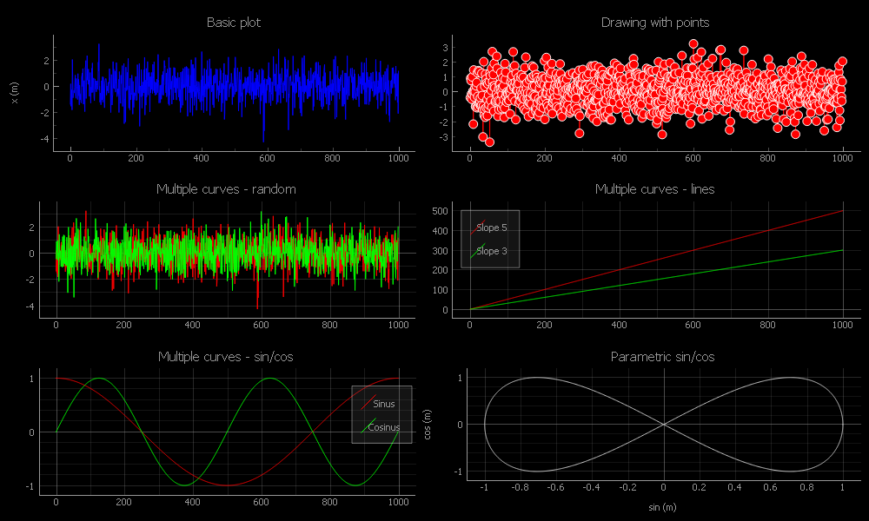

Slide 10
x=np.linspace(1,100,300)
x = np.random.normal(size=200)
x = np.random.random_integers(1,30,size=200)
pg.plot(x,y,pen=(0,255,0))
pg.plot(x,y, pen=None, symbol="x")
pg.plot(x,y, pen=(0,0,255), symbol="o", symbolBrush=(255,0,0), symbolPen=(255,255,0), symbolSize=5)
win = pg.GraphicsWindow(title="Plotting examples")
win.resize(1000,600)
p1 = win.addPlot(title="X plot")
p1.plot(x)
win.nextRow()
p1.setLabel( 'bottom', text="t", units="s")
p4.addLegend(size=(0, 30), offset=(10, 10))
p1.showGrid(x=True, y=True)

Slide 11
Serijska komunikacija
Čitanje sa serijskog porta
import serial
ser = serial.Serial("COM38", 115200)
print("connected to: " + ser.portstr)
# flush any junk left in the serial buffer
ser.reset_input_buffer()
while True:
data = ser.readline().decode().split('\r\n')
print(data[0])
ser.close()

Slide 12
Serijska komunikacija
Spremanje podataka u niz
data_volt=[]
data_time=[]
data_scale=float(data[0])*5.0/1024
current_time=time.time()-start
data_volt.append(data_scale)
data_time.append(current_time)
Nacrtati graf (po isteku vremena)
Spremiti pod imenom „serial_read_plot.py”

Slide 13
Real time crtanje grafa
otvoriti program „serial_read_plot.py”
preseliti definiranje grafa na početak (ispred main)
nakon čitanja podataka odmah ih appendati i plotati
data_volt.append(data_scale)
data_time.append(current_time)
p.clear()
p.plot(data_time, data_volt, pen=(0,0,255))
app.processEvents()
#plot_data=data_volt[-plot_data_nr:]
#plot_time=data_time[-plot_data_nr:]
#p.plot(plot_time, plot_data, pen=(0,0,255))

Slide 14
Spremanje u CSV
Pisanje po redcima
import csv
mjerenja=[2,5,6,4,2,3]
vrijeme=[1,2,3,4,5,6]
filename = "csv_redci.csv"
# otvori csv file
with open(filename, 'w', newline='') as csv_file:
wr = csv.writer(csv_file)
# zapisi podatke u .csv
wr.writerow(vrijeme)
wr.writerow(mjerenja)
Pisanje po stupcima

Slide 15
Čitanje iz CSV
Čitanje iz redaka
import csv
filename='csv_redci.csv'
podaci=[]
with open(filename, 'r') as csv_file:
wr = csv.reader(csv_file, delimiter=',')
for row in wr:
podaci.append(row)
# promjena liste stringova u listu floatova
vrijeme=list(map(float,podaci[0]))
mjerenja=list(map(float,podaci[1]))
Dodati crtanje grafa

Slide 16
Moderni eksperimenti
Vlastita grafička sučelja (GUI) za eksperimente

Slide 17
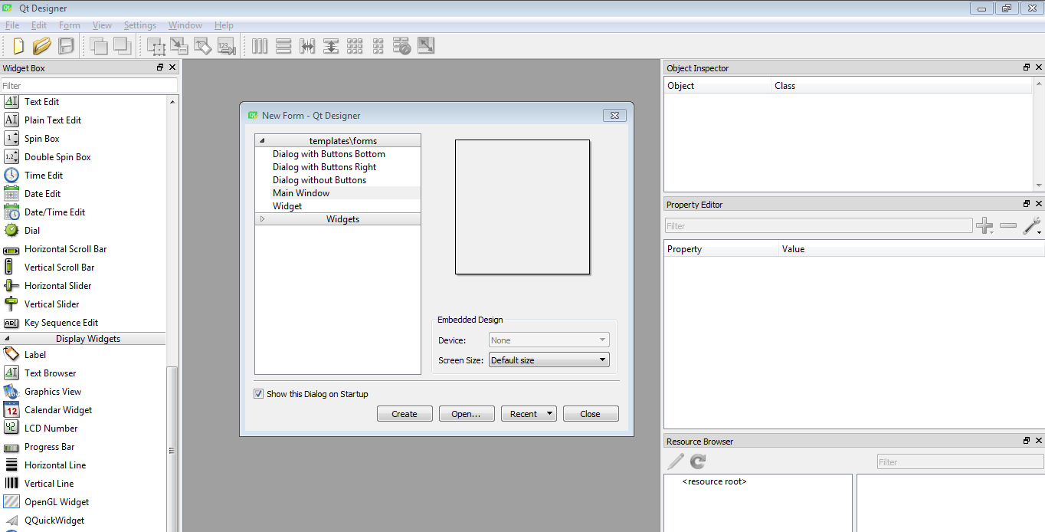
QT DESIGNER

Slide 18
KOSTUR
import sys
from PyQt5 import QtGui, QtCore, uic, QtWidgets
class MainWindow(QtWidgets.QMainWindow):
def __init__(self, parent=None):
super(MainWindow, self).__init__()
#load gui from .ui file
uic.loadUi('button.ui', self)
if __name__ == '__main__':
app = QtWidgets.QApplication(sys.argv)
w = MainWindow()
w.show()
sys.exit(app.exec_())

Slide 19
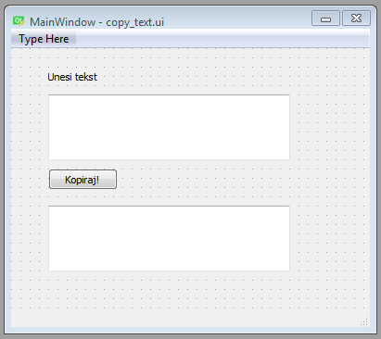
ZADATAK: Copy text
tekst=self.unos_teksta.toPlainText()

Slide 20
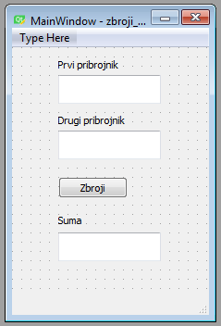
ZADATAK: Kalkulator za ZBRAJANJE
num1=float(self.first_box.toPlainText())
num2=float(self.sec_box.toPlainText())
self.result_box.setText(str(num1+num2))

Slide 21
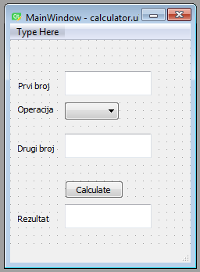
ZADATAK: Kalkulator ZA +, -, *, /
operation=self.izbornik.currentText()
if operation=="+":
result=num1+num2
elif …

Slide 22
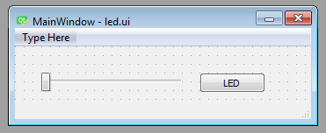
SERIAL WRITE: SLIDER I LED
led_value=self.sld_led.sliderPosition()
print(led_value)
ser.write(bytes([led_value]))
Arduino
if(Serial.available()>0){
ledValue=Serial.read();
analogWrite(ledPin,ledValue);
}

Slide 23
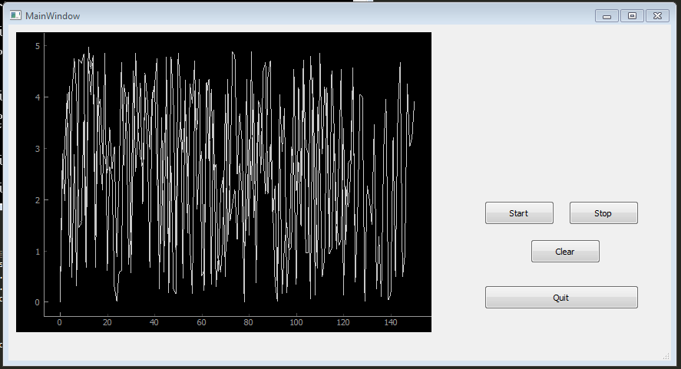
REAL TIME GRAF U GUIu

Slide 24
REAL TIME GRAF U GUIu
1. DODATI: čitanje podataka sa serijskog porta
Postavljanje serijskog porta
Čitanje podataka
self.ser = serial.Serial("COM38", 115200) self.ser.reset_input_buffer()
data = self.ser.readline().decode().split('\r\n') data_scale = float(data[0]) * 5.0 / 1024

Slide 25

REAL TIME GRAF U GUIu
2. DODATI: spremanje podataka u SCV
dodati gumb za spremanje
napisati funkciju za spremanje
self.btn_save.clicked.connect(self.save_CSV)
def save_CSV(self):
self.filename = "measurements.csv"
self.length=len(self.data)
with open(self.filename, 'w', newline='') as self.csv_file:
wr = csv.writer(self.csv_file)
for i in range(self.length):
this_row=[self.data_time[i], self.data[i]]
wr.writerow(this_row)

Slide 26

REAL TIME GRAF U GUIu
3. DODATI: postavljanje Y osi grafa iz GUIa
self.Ymin=0.0
self.ln_ymin.textChanged.connect(self.Ymin_changed)
def Ymin_changed(self):
if self.ln_ymin.text()!='':
self.Ymin=float(self.ln_ymin.text())
self.p.setYRange(self.Ymin, self.Ymax)

Slide 27
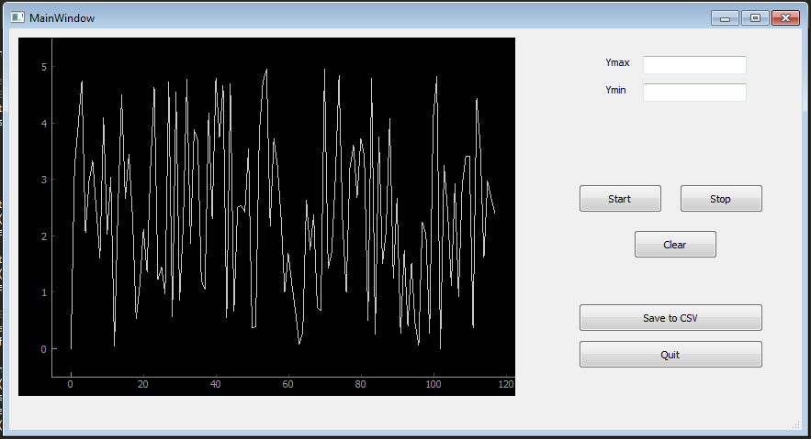
REAL TIME GRAF U GUIu
Gotov program: „gui_graph_final.py” i „gui_graph_final.ui”

Slide 28
Hvala!
ISPUNITE ANKETU!

